Slide 1
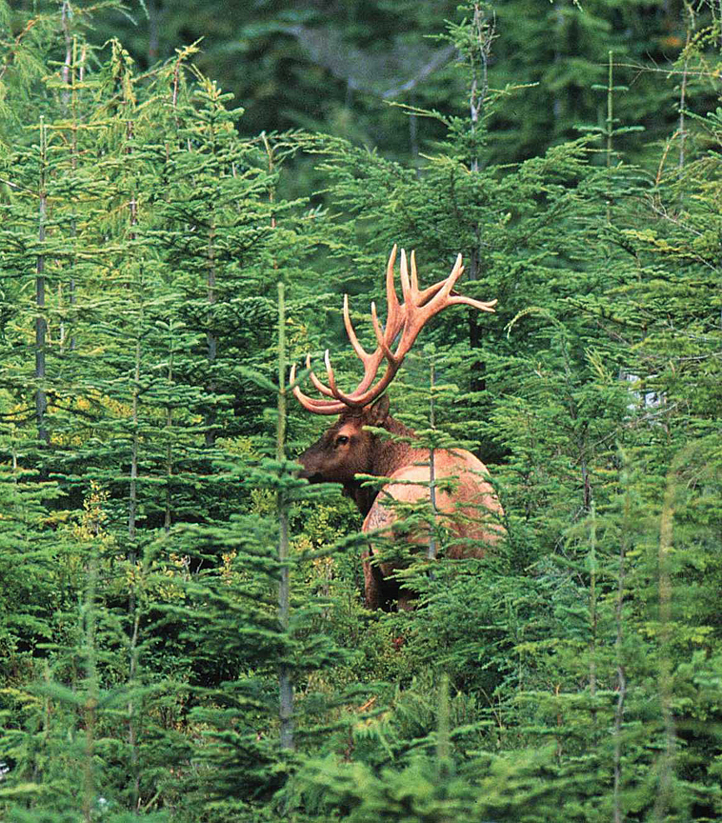

Roosevelt Elk
Discussion
Paper and
Management
Plan
Update – September 2012

Slide 2
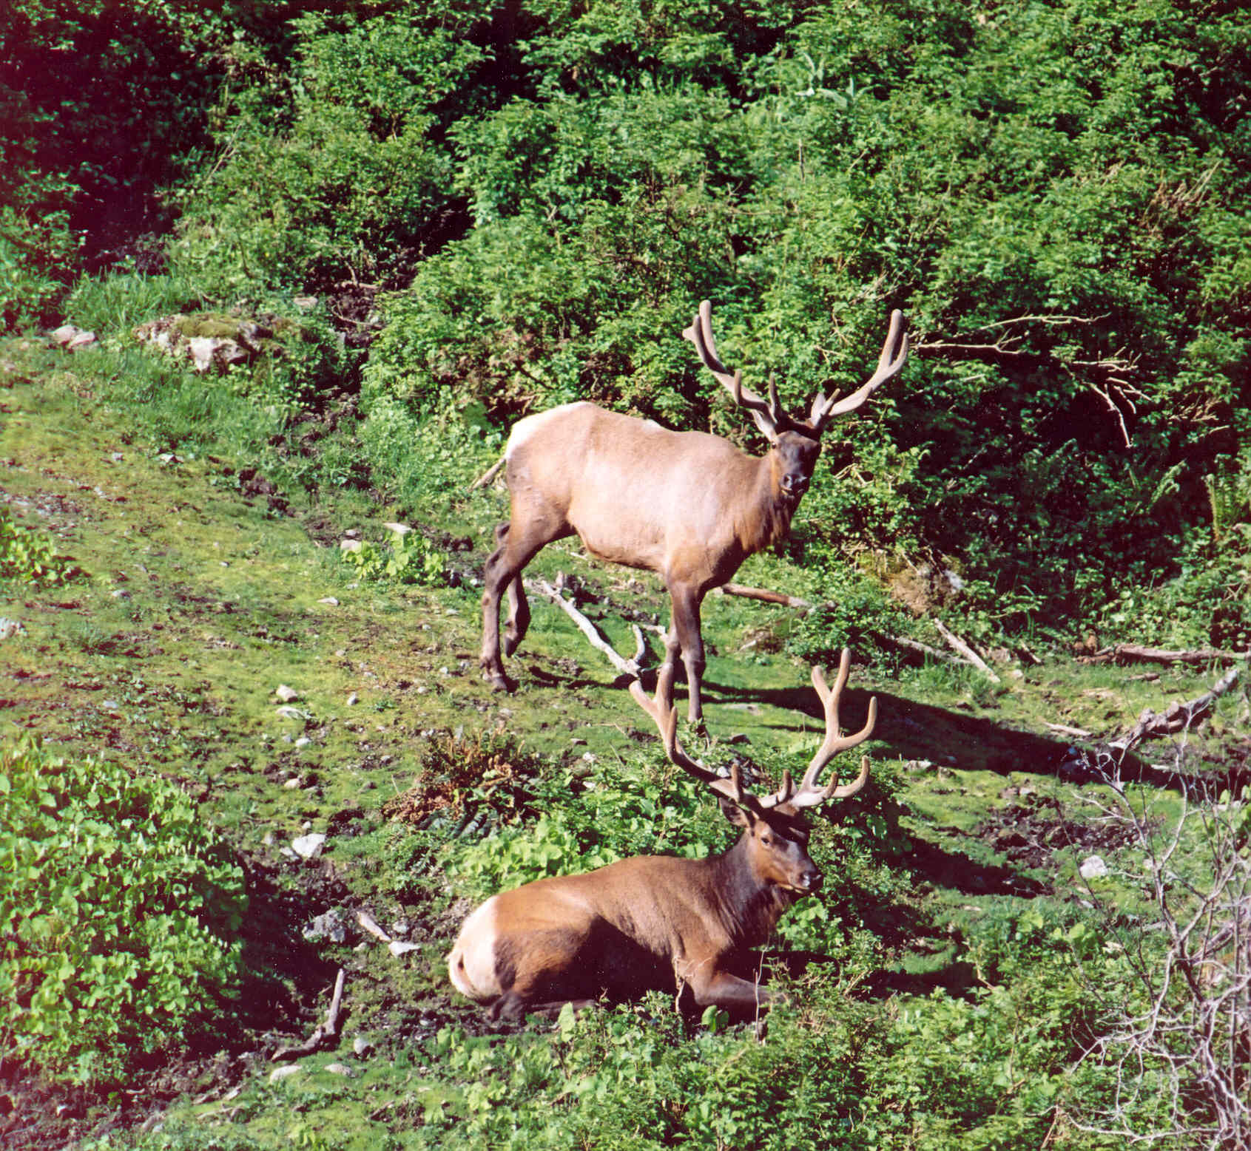
In fiscal 2011-2012 we began the journey of creating a management plan.
3 Step Process
Step 1 - write a discussion paper (Completed May 2012)
Step 2 – engage in discussions with appropriate groups
(In progress)
Step 3 – write a management plan

Slide 3
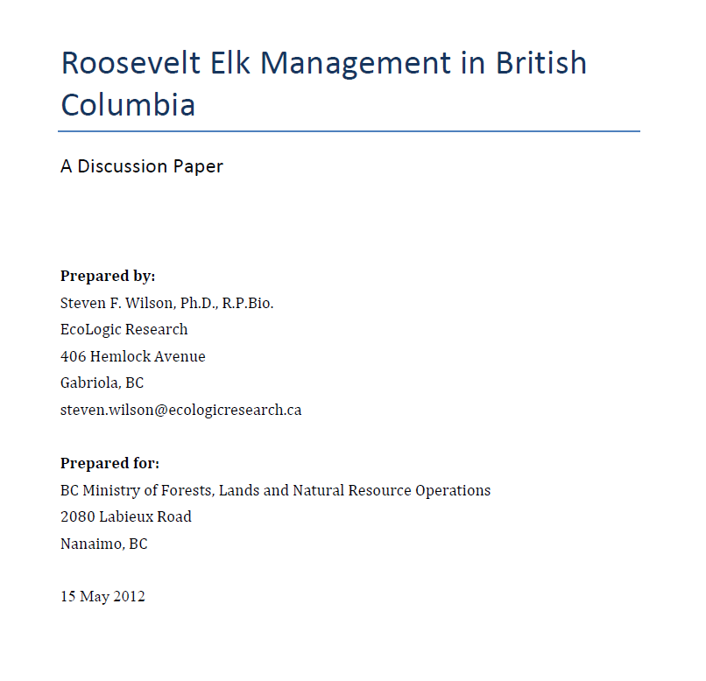
Step 1 – Write a Discussion Paper
Input from South Coast Region and West Coast Region staff
References the CRIT documents
Complementary to other ministry/government initiatives
Starting point for discussion
PDF Version available

Slide 4
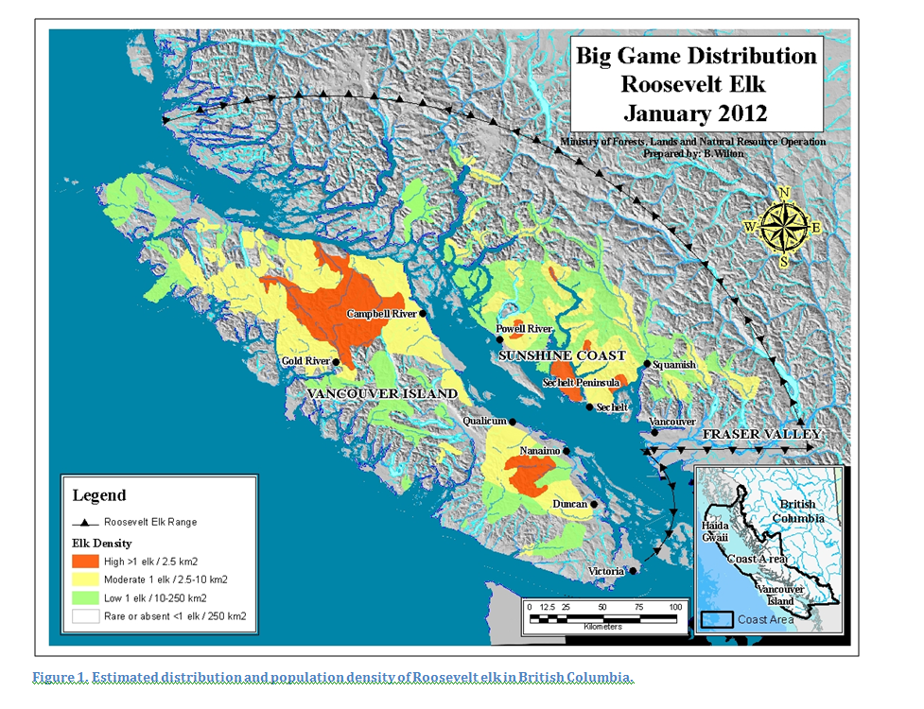

Slide 5
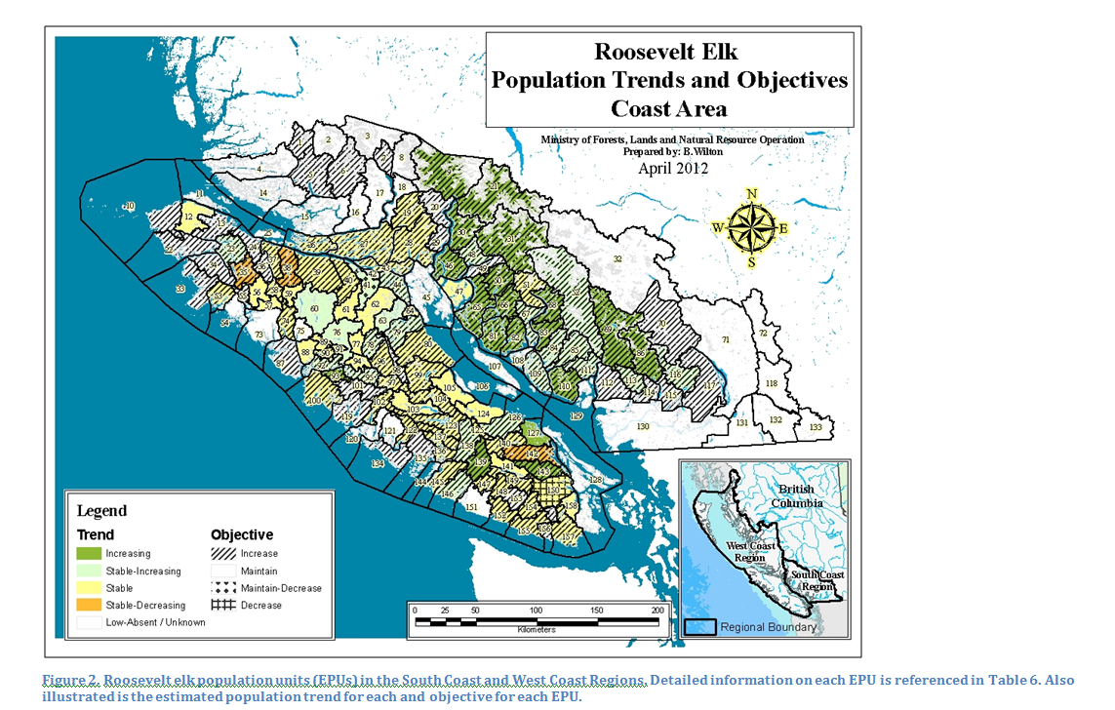

Slide 6
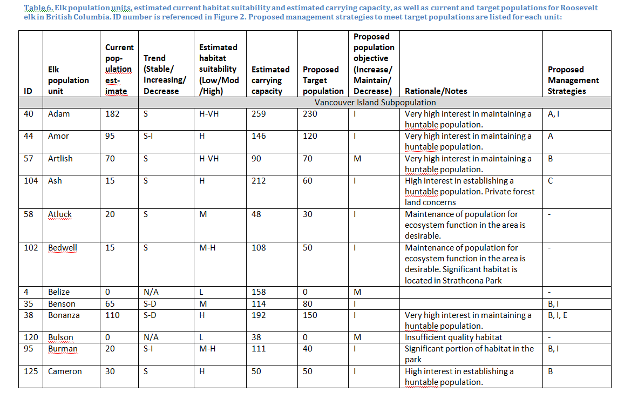

Slide 7
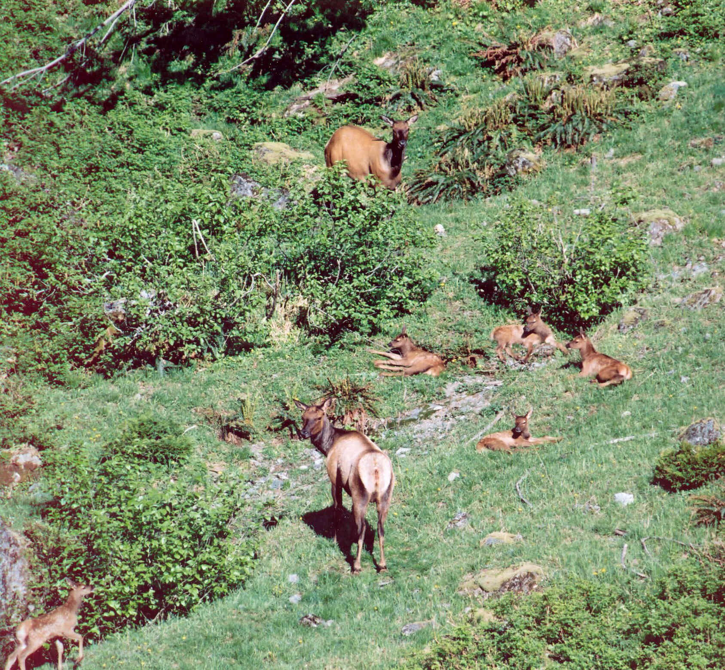
Step 2 – Engage Groups for Discussion
First Nations
Sent to First Nations on May 29th, 2012
Responses received from several First Nations
Will need to make contact for full engagement

Slide 8
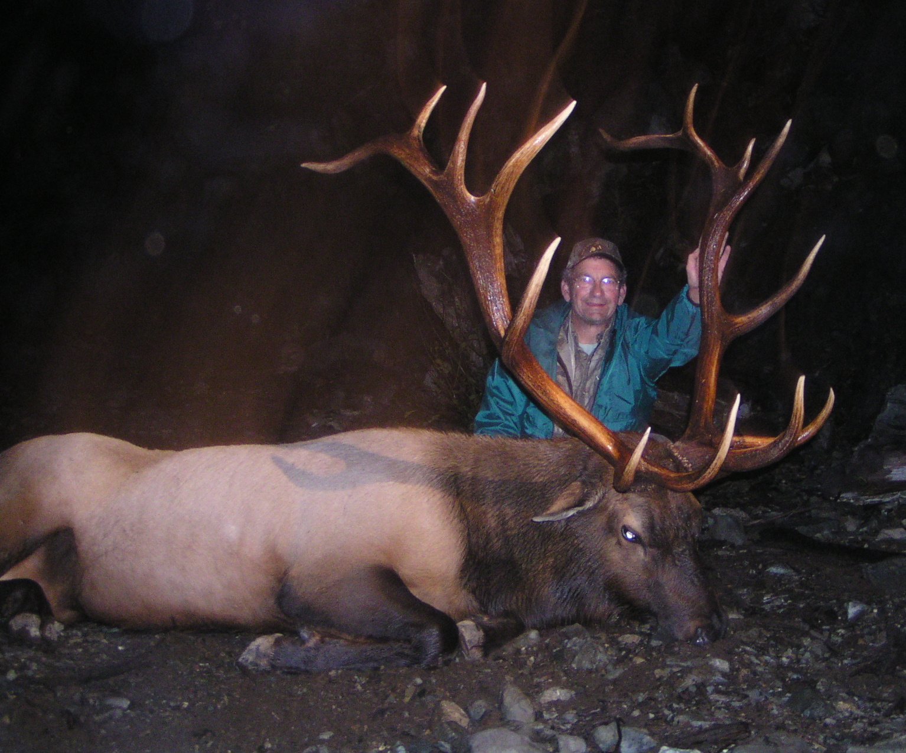
Step 2 – Engage Groups for Discussion
Other Stakeholders
Sent to stakeholders July 2012
Responses by the end of October 2012.
Forest licensees
BCWF
Coastal Guides/GOABC
BCTA
Agencies
Regional Districts
Notes:
BCWF – zone and provincial
Wildlife Br. HQ
RMT

Slide 9
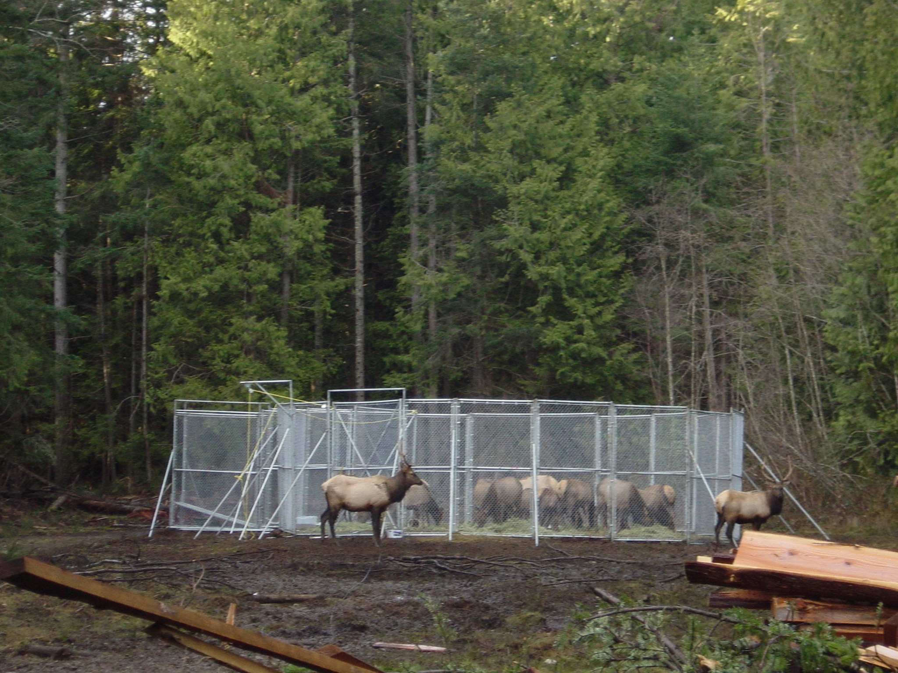
Step 2 – Engage Groups for Discussion
Approach
Meetings / Workshops :
(Nov 2012 – Feb 2013)
Industry
Forest Stewardship
Wildlife User Groups
Fish & Wildlife
First Nations meetings
Fish & Wildlife
First Nations Manager
Agencies
Fish & Wildlife

Slide 10
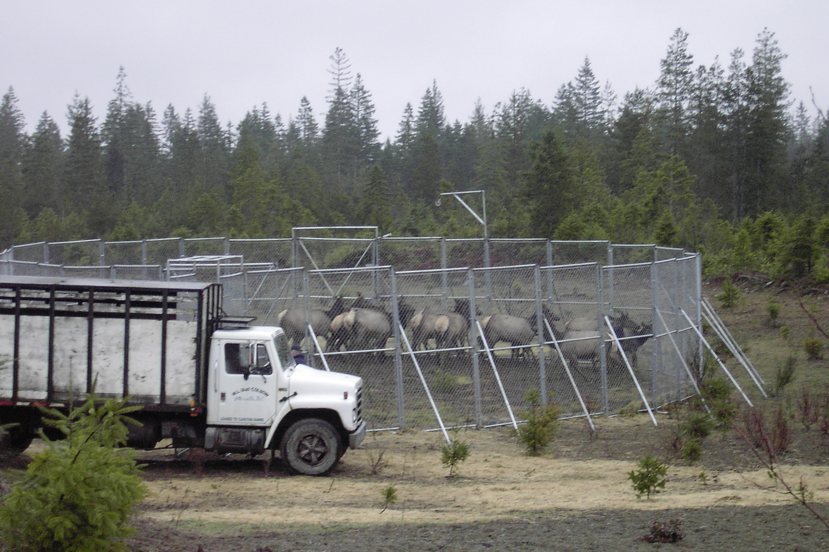
Step 2 – Engage Groups for Discussion
Resources Required
Project endorsement by Regional Management Teams (RMT)
Nanaimo & Surrey
Capacity:
Kim has retired
  Interregional coordination
  Communicate / file
Decision Notes
Info Notes
Funding from RMT approved- $40,000
Facilitator
Workshops
Travel
Management Plan

Slide 11
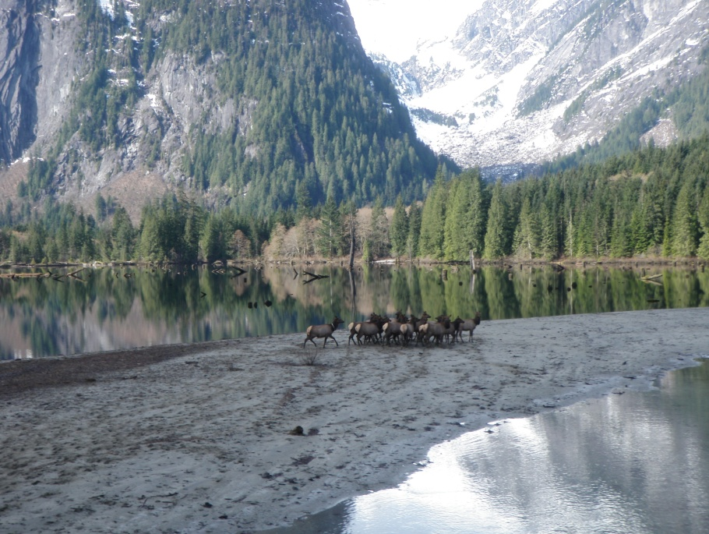
Step 2 – Engage Groups for Discussion Resources Required
Hire contractor support Fish & Wildlife
Estimated $40,000 budget
Attend and facilitate stakeholder meetings where required
Track discussions, comments, ideas
Review and incorporate ideas into final plan

Slide 12
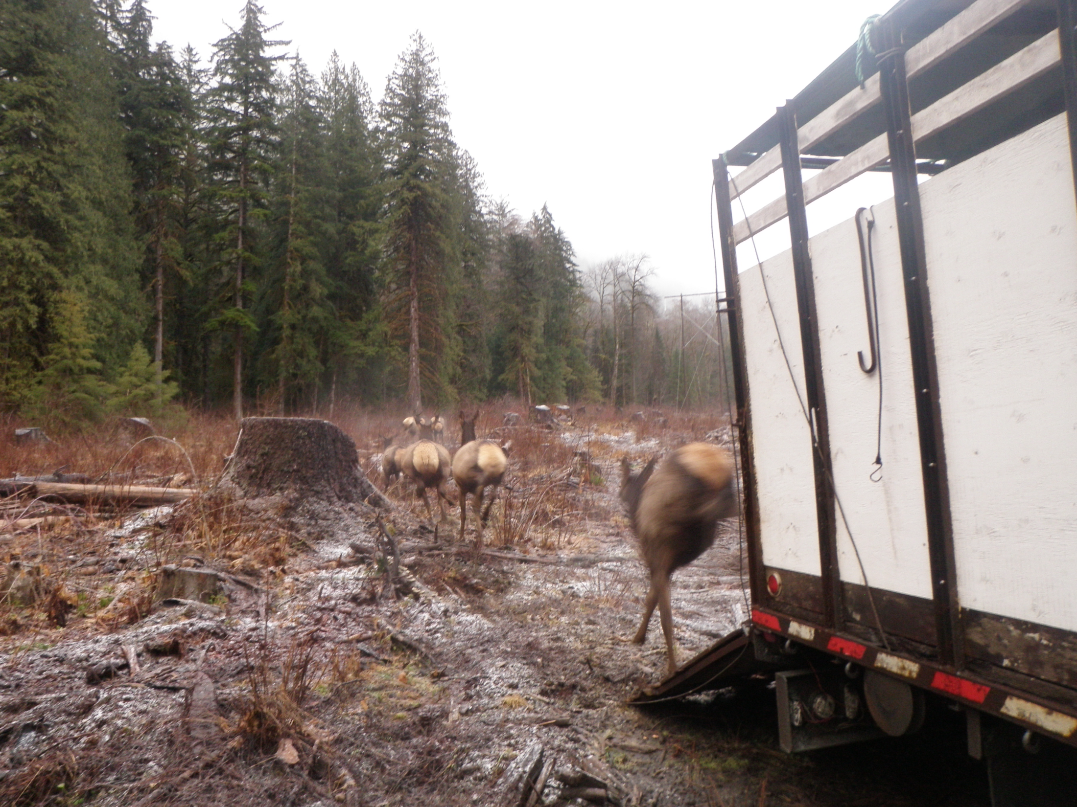
Step 3 – Write a Management Plan
Address comments and incorporate into draft
Nov 2012-Feb 2013
Balance objectives
Risks
Capacity
Funding
Election mode
Final Roosevelt Elk Management Plan
Spring 2013

Slide 13
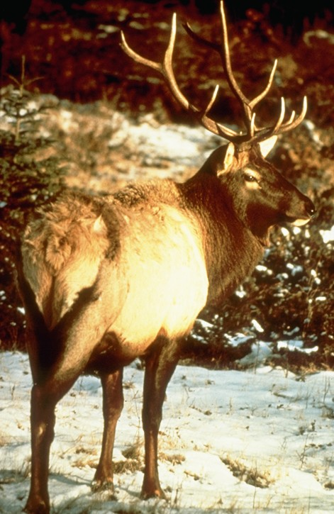
The End
Questions?

